Slide 1
R Programming Course
2. Data Structures

Slide 2

R Programming Course
2.1 Variables and assignment
Variables
A variable is an identifier (name) that points to a memory location in RAM that stores a value that can change when the program is run.
Assignment
Set up a vector, x
Putting a value into a variable is known as assignment.
R uses to work with temporary variables in the functions, with only a return().
If you assign a variable in the Global environment or when you are using functions more than scripts, you can use
super-assignment operator: <<-
assign function: assign("b“ ,value, envir = globalenv())

Slide 3
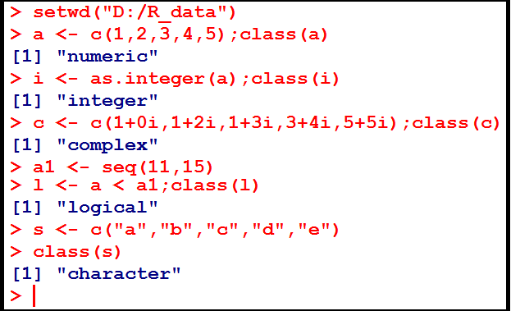
R Programming Course
2.2 Data Types
Basic Data types in R
Numeric
Integer
Complex
Logical
Character

Slide 4
R Programming Course
2.2 Data Types - continued
Data object type | Description
Vector | a sequence of numbers or characters, or higher-dimensional arrays like matrices
list | a collection of objects that may themselves be complicated
factor | a sequence assigning a category to each index
data.frame | a table-like structure
Environment (hash-table) | A collection of key-value pairs

Slide 5

R Programming Course
2.2 Data Types - continued
Data objects
Vector
List
Factor
Data frame
Matrix
Time Series
A name (a.k.a symbol) is a way to refer to R objects by name.

Slide 6
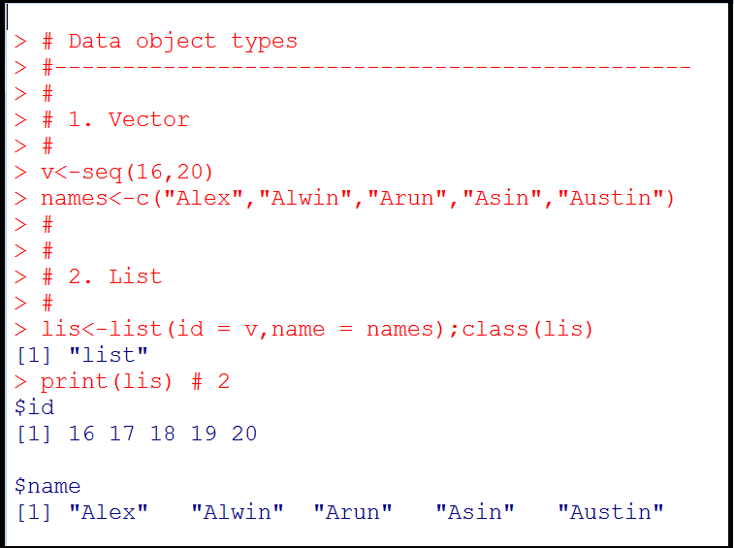
R Programming Course
2.2 Data Types - continued

Slide 7
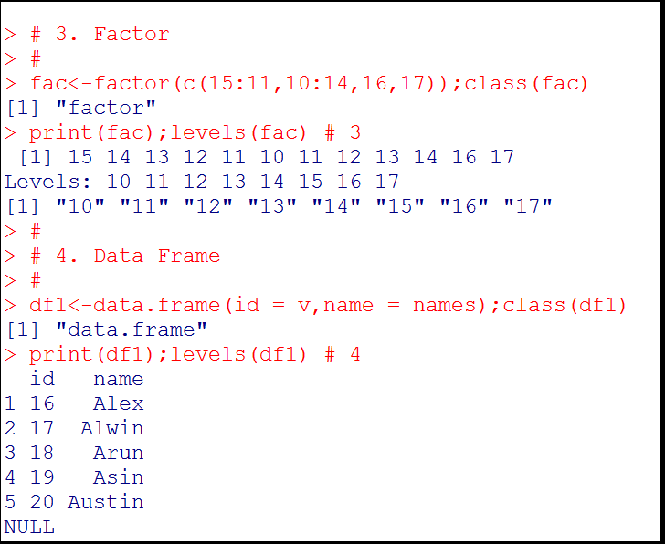
R Programming Course
2.2 Data Types - continued

Slide 8
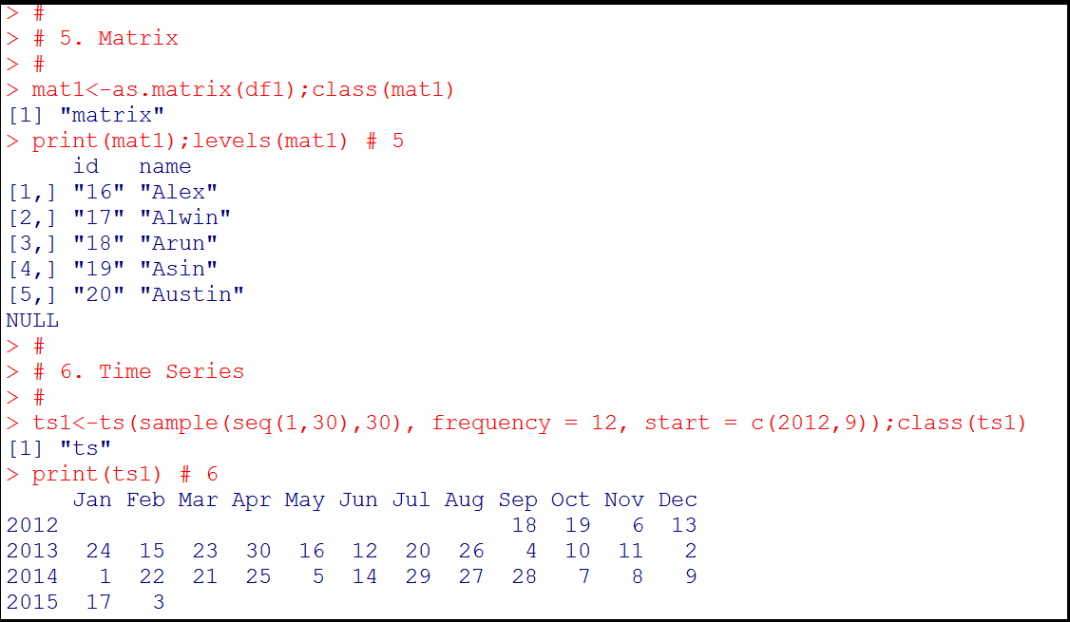
R Programming Course
2.2 Data Types - continued

Slide 9
R Programming Course
2.3 Indexing, sub-setting
R contains several constructs which allows access to individual elements or subsets through indexing operations.
In case of the basic vector types one can access the ith element using x[i], but there is also indexing of lists, matrices, and multi-dimensional arrays.
There are several forms of indexing in addition to indexing with a single integer.
Indexing can be used both to extract part of an object and to replace parts of an object (or to add parts).

Slide 10
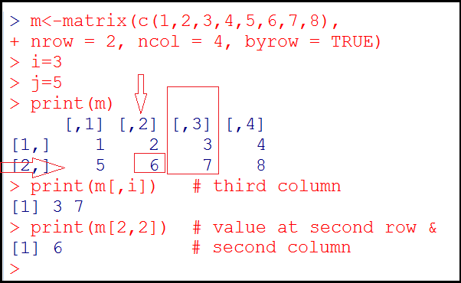
R Programming Course
2.3 Indexing, sub-setting - continued
There are three subsetting operators [ ], [ [ ] ] and $.

Slide 11
R Programming Course
2.3 Indexing, sub-setting - continued
[[ is similar to [, except it can only return a single
value and it allows you to pull pieces out of a list.
$ is a useful shorthand for [[ combined with character subsetting.
You need [[ when working with lists.
This is because when [ is applied to a list it always returns a list; it never gives you the contents of the list. to get the contents, you need [[.
Reference:
http://stackoverflow.com/questions/22431261/understanding-list-indexing-and-bracket-conventions-in-r

Slide 12
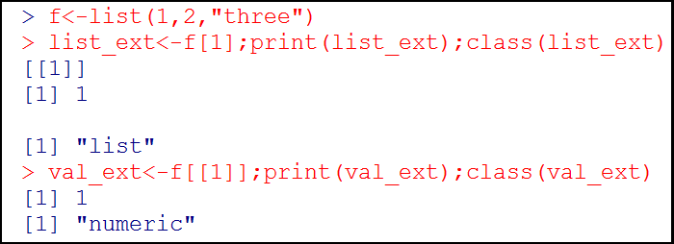
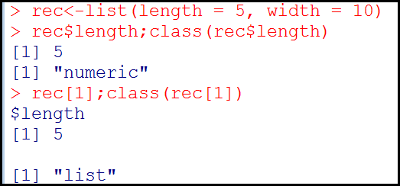
R Programming Course
2.3 Indexing, sub-setting - continued

Slide 13

R Programming Course

Slide 14
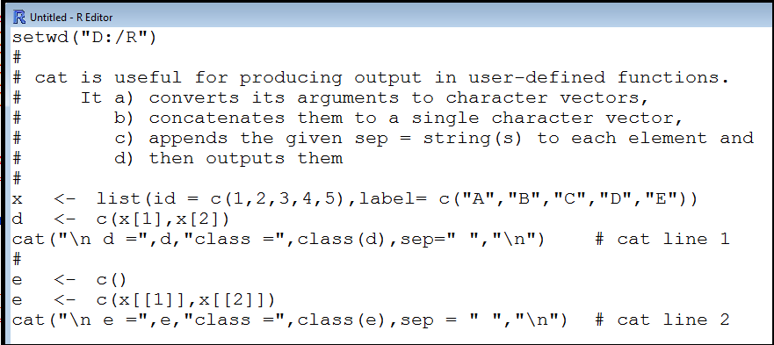
R Programming Course
Which line(s) in the following code snippet produces error?
a) Both cat line 1 and cat line 2
b) Neither cat line 1 nor cat line 2
c) Only cat line 1
d) Only cat line 2
Note: cat can handle only atomic vectors or names.

Slide 15
R Programming Course
The four main modes, which describe the basic type of elements of the object. They are:
Numeric
Character
_________
Logical
The missing type is:
Binary
Complex
All of the above
None of the above

Slide 16
R Programming Course
3. If I execute the expression i <- 50 in R language, what is the value of class(x)?
a) Numeric
b) Integer
c) Real
d) complex
4. What is the class of the object defined by the expression a <- c(120,"i",FALSE)?
a) Numeric
b) Character
c) Integer
d) Logical

Slide 17
R Programming Course
c) cat line 1
b) Complex
a) Numeric
b) Character

Slide 18

R Programming Course

Slide 19
R Programming Course
Lab Exercise 1:
All the 100 students are assigned Student ID ranging from 1 to 100. Select ten students from B.Com Final year at random.
The importance of the theory of sampling lies in the fact that for a large population, it is neither practical nor possible to collect data for each and every number of the population.

Slide 20
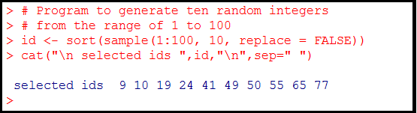
R Programming Course
Lab Exercise 1 - continued:
The function sample generates random integers without replacement.
The first argument specifies a vector containing the specified range of valid numbers.
The second argument indicates the number of random integers to be returned.
The function sort, sorts the output.

Slide 21
R Programming Course
Lab Exercise 2:
Find the mean, median and mode of the set of following observations:
27,36,28,18,35,26,20,35,40,26
An average is considered as a typical representative of the whole data.
The various averages in common use are:
1. Mean
2. Median
3. Mode

Slide 22
R Programming Course
Lab Exercise 2 – continued:
Arithmetic mean is the most popular measure of central tendency.
Median is the middle value for a data that has been arranged in order of magnitude. The median is less affected by outliers and skewed data.
Mode is the value that occurs most often in the data set.

Slide 23
R Programming Course
Lab Exercise 2 – continued:
The functions mean() and median() calculates the mean and median of the given data set respectively.
However, we need to write a function to calculate mode. Note that the mode is a reserved word in R and it denotes the basic data type.

Slide 24
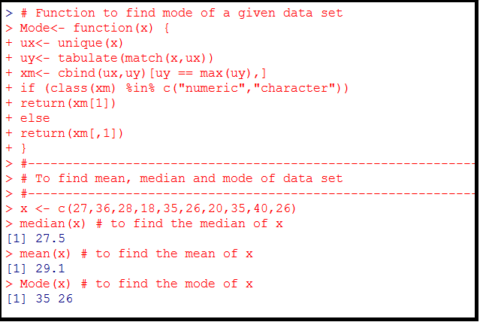
R Programming Course
Lab Exercise 2 - continued:

Slide 25
R Programming Course
Lab Exercise 3:
Find the first quartile, median and third quartile; 5th percentile and 95th percentile of the twenty random integers ranging from 1 to 1000.
The first quartile is the value that cuts off the first 25% of the data when it is sorted in ascending order.
The second quartile or median is the value that cuts off the first 50% of the data when it is sorted in ascending order.

Slide 26
R Programming Course
Lab Exercise 3 - continued:
The third quartile is the value that cuts off the first 75% of the data when it is sorted in ascending order.
The nth percentile of a data set is the value that cuts off the first n-percent of the data values when it is sorted in ascending order.

Slide 27
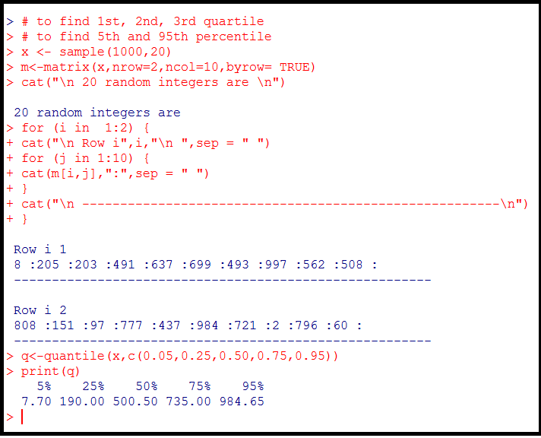
R Programming Course
Lab Exercise 3 - continued:

Slide 28
R Programming Course
Lab Exercise 4:
There are two types of electric bulbs. Samples of size 30 are drawn each from the two types.
Mean life in hours of type I electric bulbs:
510,500,495,480,520,485,510,500,495,480,
520,485, 510,500,495,480,520,485,500,505,
501,502,498,490,512,498,505,504,491,489
Mean life in hours of type I electric bulbs:
610,580,595,580,620,595,610,600,598,580,
620,595,610,600,608,607,608,605,600,605,
601,602,598,599,612,598,605,604,591,596
Which type of electric bulb has more variation and the range of the life in hours for both types?

Slide 29
R Programming Course
Lab Exercise 4 continued:
By dispersion, it is meant spreading of the observations from an average.
They measure the variability in the observed values in a data set.
Range is defined to be the difference between the largest and the smallest of the observations.

Slide 30
R Programming Course
Lab Exercise 4 - continued:
The standard deviation measures the variability between observations in the sample or population from the mean of that sample or population.
Coefficient of variation is the relative measure of dispersion based on standard deviation; it is defined by (SD/Mean) * 100.
It is used to compare dispersion in two sets of data especially when the units are different.

Slide 31
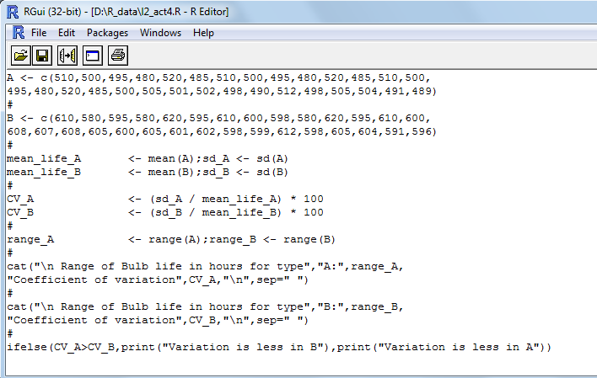
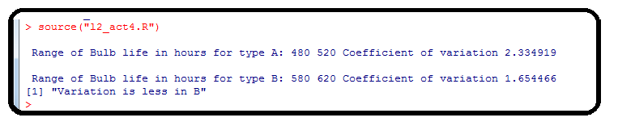
R Programming Course
Lab Exercise 4:

Slide 32

R Programming Course
Lab Exercise 5:
Monthly series of income from sales in lakhs of Indian Rupees for a large retail store in Chennai for the years 2010 and 2011 are given below:
Predict the income from sales for the year 2012 and plot in a graph the trend line from 2012 to 2016.

Slide 33
R Programming Course
Lab Exercise 5 - continued:
A time series is a set of observations, measured typically at successive points in time spaced at uniform time intervals and arranged in chronological order.
Time series are used in weather forecasting, earthquake prediction, and largely in any domain of applied science and engineering which involves temporal measurements.
Examples of time series include:
the hourly series of temperature recorded by the Meteorological observatory
the daily series closing price of shares in the National Stock Exchange

Slide 34
R Programming Course
Lab Exercise 5 - continued:
Time series analysis comprises methods for analyzing time series data in order to extract meaningful statistics and other characteristics of the data.
Time series forecasting is the use of a model to predict future values based on previously observed values.
The Holt- Winters forecasting procedure is a widely used projection method which can cope with trend and seasonal variation.

Slide 35
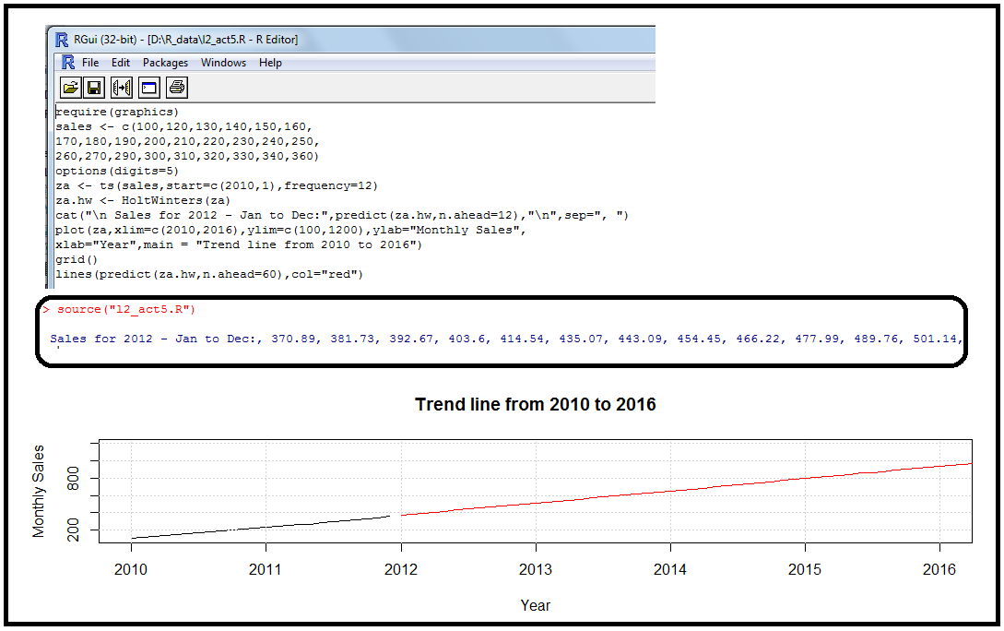
R Programming Course
Lab Exercise 5 - continued:

Slide 36
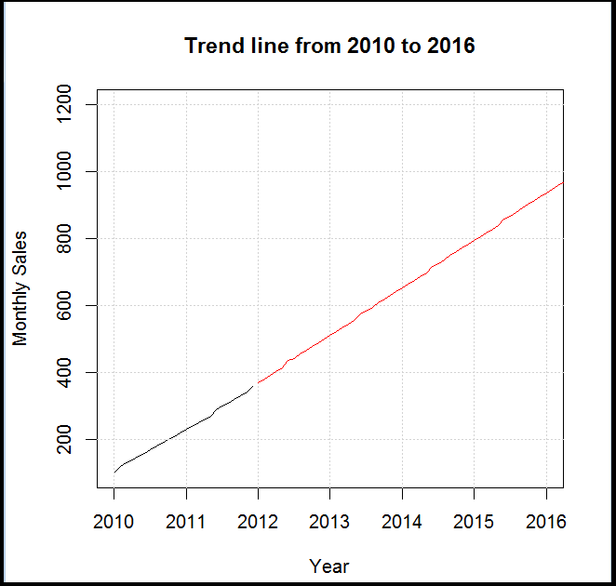
R Programming Course
Lab Exercise 5 - continued:

Slide 37
R Programming Course
Lab Exercise 5 - continued:
Sales vector is converted to a time series object, za.
HoltWinters procedure is performed on dataset, za and stored in za.hw.
Using the predict function, sales for the next 12 months are predicted.
The time series observed values and predicted values are plotted in a graph.
Grid lines are drawn in the graph.
Lines are drawn through the predicted points for 60 months from 2010 using the color red.

Slide 38
R Programming Course
Lab Exercise 6
Six tomato plants, of the same variety, were selected at random and treated, weekly, with x grams of fertilizer dissolved in water. The yield of plant is recorded in kilograms.
Calculate the equation of the least squares regression line of y on x.
Estimate the yield treated weekly with 3.1 grams of fertilizer.
Plant | A | B | C | D | E | F
x | 1.1 | 2.3 | 2.4 | 3.5 | 2.0 | 4.0
y | 4.5 | 6.4 | 6.7 | 7.4 | 5.7 | 7.5

Slide 39
R Programming Course
Lab Exercise 6 - continued:
A simple linear regression model that describes the relationship between two variables x and y can be expressed as y= f(x); where y is called the response variable and x the predictor variable.
The strength of the relationship is revealed by the correlation coefficient.
Linear regression consists of finding the best-fitting straight line through the points (observations).

Slide 40
R Programming Course
Lab Exercise 6 - continued:
A line of best fit is a straight line that is the best possible approximation of the given set of data. It is used to study the nature of relation between two variables.
Least squares is a technique we use for data fitting in linear regression.
The error of prediction for the response (y) is the value of response (y) minus the predicted value using the regression equation.

Slide 41
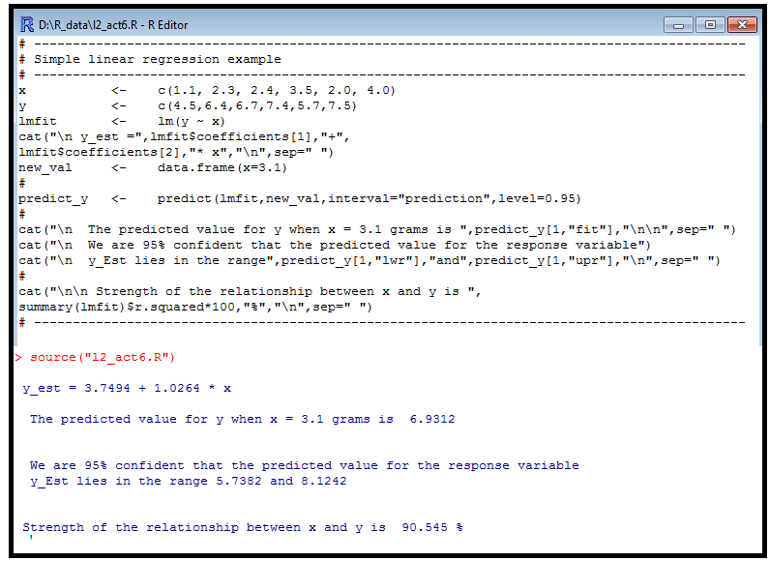
R Programming Course
Lab Exercise 6 - continued:

Slide 42
R Programming Course
Lab Exercise 7
The famous iris data set gives the measurements in centimeters of the variables sepal length and width and petal length and width, respectively, for 50 flowers from each of three species of iris. The species are Iris setosa, versicolor, and virginica.
Source: Fisher R.A (1936) The use of multiple measurements in taxonomic problems Annals of Eugenics 7 Part II 179-188.
Apply the function, describe() of psych package which provides the ones most useful for scale construction and item analysis in classic psychometrics.

Slide 43
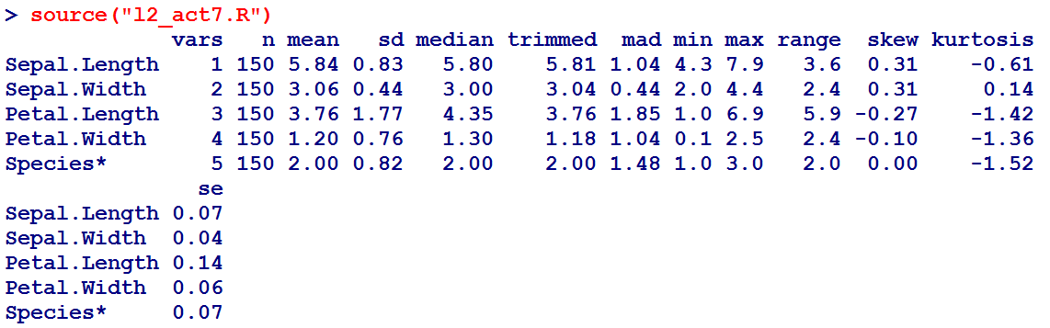
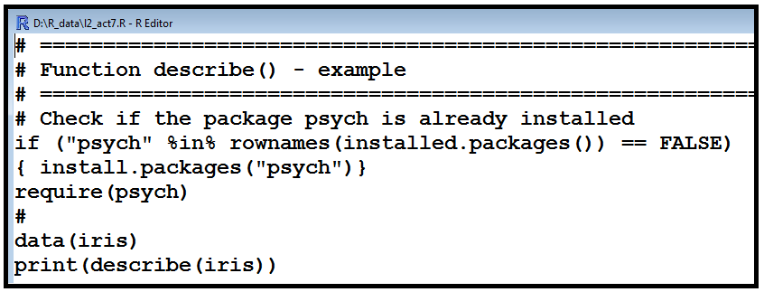
R Programming Course
Lab Exercise 7 - continued:

Slide 44
R Programming Course
Read the file “U04_R Data Types_v1.pdf“ under Detailed Material

